Slide 1
Tender Briefing Session For Berth 605
Presented By: Keith Goulding
Date: 17 November 2023
Notes:
Growth and Reinvent

Slide 2
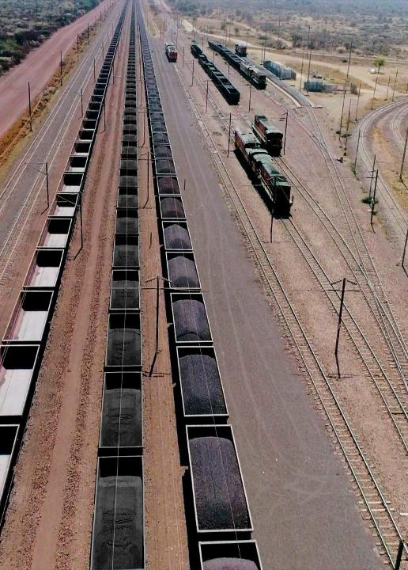
Contents
Tender Briefing – Berth 605
01 | Introduction
02 | Project scope
03 | Technical Evaluation Criteria
04 | Q&A
2

Slide 3
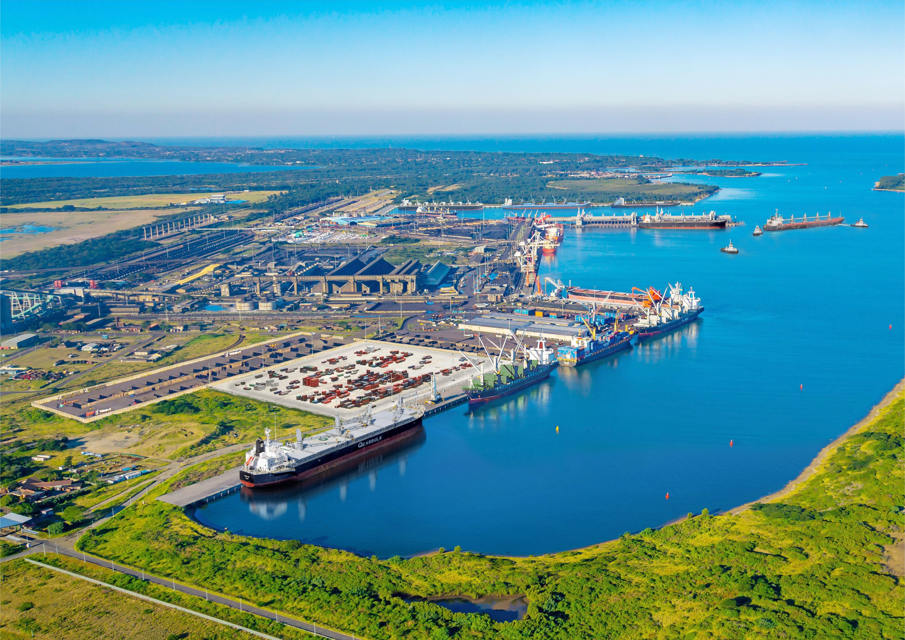
Introduction New Berth 605
New Berth 605

Slide 4
Project Scope Overview
Berth 605
The Port of Richards Bay handles containers at the 600 – series berths.
In terms of the current set up, one berth handles containers for half the year and the rest of the year this berth is used for break bulk cargo.
It is TNPA’s intention to develop a dedicated Container Handling Facility with a dedicated berth within the 600 series berths for the exclusive use of containers.
The Container Handling Facility will be developed in accordance with a process as outlined in Section 56 of the National Ports Act, and other than those services required as per Task Order 1, will not form part of this Scope.
In summary the services required for this project are as follows:
Confirm concept design
Complete the detail design
Produce and evaluate options for the various development packages
Produce schedules, cost estimates, constructability sequencing, risks and assumptions, for preparation of the business case to secure funding
Prepare an execution business case
Provide procurement support to the Employer
Undertake construction management services
Undertake pre-commissioning activities and support project commissioning until certification is obtained

Slide 5
Project Scope Overview – Continue
Berth 605 (Summary of Service required continued)
Provide end of project documentation
Undertake all environmental approval requirements
Support the Employer with stakeholder engagements
Support the Employer with technical requirements and queries, and provide support for the Container Handling Facility Operator
Prepare and supply all documentation and reports for the TNPA gate review process
Provide on-the-job training, skills transfer and mentorship to the Employer’s Team
The scope of services is broken down into 5 task orders, with each task order covering a different Development Package. Time allocated for each Task Order is as per the following:
Each Task Order will be awarded individually as determined at a point in time during the execution of the project. It is not necessary that each Task Order be awarded sequentially. The award will be based on the need for the execution of the Task Order.
Task Order 1
4 months
Task Order 2
11 months
Task Order3
6 months
Task Order4
22 months
Task Order 5
22 months

Slide 6
Project Scope Overview – Continue
Description: Concept design
Scope:
Task Order 1 focuses on preliminary design for the port authority infrastructure as well as the Facility Operator infrastructure development. Both developments are to be designed, and cost estimates provided for each development.
Deliverables:
Geotechnical investigations
Surveys
Engineering model and operating philosophy
Traffic studies
Work break down structure
Early works
Preliminary cost estimates
Project schedule
Stakeholder engagement
Business case inputs
3D rendered drawing
Operating philosophy
Timeline: 4 months
Task Order 01
Task Order 02
Task Order 03
Task Order 04
Task Order 05

Slide 7
Project Scope Overview – Continue
Description: Detail design
Scope:
The primary deliverables for Task Order 2 is the provision of detailed designs and legislative approvals for the Berth 605 quay wall infrastructure only.
Deliverables:
Detail design drawings
Works information
Final cost estimates
Construction schedule
Execution plan
Health and safety relevant notifications and compliance
Execution Business case
Prepare bid documents for construction
Environmental authorisations and permits
Gate review process
Timeline: 11 months
Task Order 01
Task Order 02
Task Order 03
Task Order 04
Task Order 05

Slide 8
Project Scope Overview – Continue
Description: Procurement Support
Scope:
Task Order 3 involves procurement deliverables and support and will be issued once capital funding is available to proceed with the appointment of a construction contractor.
Deliverables:
Technical queries
Tender clarifications
Site visits
Tender briefing meeting
Technical evaluations
Timeline: 6 months
Task Order 01
Task Order 02
Task Order 03
Task Order 04
Task Order 05

Slide 9
Project Scope Overview – Continue
Description: Engineering and construction management
Scope:
Task Order 4 involves the construction phase of the project. It entails engineering supervision that will be undertaken by the Consultant, and construction supervision and management of the construction contractor by the Consultant.
Activities:
NEC project management
NEC contract management
NEC site supervision
Schedule, Cost, Quality & SHE management
Invoice and payment processing
Management of Contractor disputes
Contract close out and submission of data packs
Social and stakeholder monitoring
Timeline: 22 months
Task Order 01
Task Order 02
Task Order 03
Task Order 04
Task Order 05

Slide 10
Project Scope Overview – Continue
Description: Commissioning and Facility Operator support
Scope:
Task Order 5 involves commissioning of the facility and the provision of technical support during the Bid process phase of appointing a Facility Operator. The Consultant will also provide technical support to the Facility Operator during the construction phase of the facility by the Facility Operator.
Activities:
Commissioning of TNPA infrastructure
Facility Operator support
Timeline: 22 months
Task Order 01
Task Order 02
Task Order 03
Task Order 04
Task Order 05

Slide 11
Tender Briefing Session
Evaluation Criteria

Slide 12
Evaluation Criteria
CRITERIA | WEIGHT
T2.2-02: MANAGEMENT & CVs OF KEY PERSONS | 60
T2.2-03: APPROACH PAPER | 20
T2.2-04: COMPANY EXPERIENCE | 10
T2.2-05: PROGRAMME | 10
TOTAL | 100
MINIMUM OF 70 POINTS MUST BE OBTAINED ON FUNCTIONALITY ORDER TO PROCEED TO THE NEXT STAGE OF EVALUATION

Slide 13
Evaluation Criteria – Continue
T2.2-02
MANAGEMENT & CVs OF KEY PERSONS
60 POINTS
Evaluation Criteria: Qualifications, Training and skills, Professional Registrations, and years of experience
Engineering Manager
Senior Design Engineer
Marine/Structural Engineer
Civil/Transportation Engineer
Electrical Engineer
Senior Project Manager
Senior Construction Manager
Environmental Manager
Safety Agent
Project Controls Manager
Quantity surveyor
Quality officer
Contract administrator
T2.2-03
APPROACH PAPER
20 POINTS
T2.2-04
COMPANY EXPERIENCE
15 POINTS
T2.2-05
PROGRAMME
10 POINTS

Slide 14
Evaluation Criteria – Continue
T2.2-02
MANAGEMENT & CVs OF KEY PERSONS
55 POINTS
Evaluation Criteria:
Outline of proposed approach
Feasibility design development approach
Design Reviewing process
Detailed list of other resources, professional skills and utilisation including a resource matrix
Management tools and system
Works Information (design philosophy)
Detailed method statement, technical approach and Task Order 1 and 2 sequencing in terms of the scope
T2.2-03
APPROACH PAPER
20 POINTS
T2.2-04
COMPANY EXPERIENCE
15 POINTS
T2.2-05
PROGRAMME
10 POINTS

Slide 15
Evaluation Criteria – Continue
T2.2-02
MANAGEMENT & CVs OF KEY PERSONS
55 POINTS
Evaluation criteria:
Similar projects: Minimum 2 similar type projects
Number of references: Minimum 2 references
T2.2-03
APPROACH PAPER
20 POINTS
T2.2-04
COMPANY EXPERIENCE
10 POINTS
T2.2-05
PROGRAMME
10 POINTS

Slide 16
Evaluation Criteria – Continue
T2.2-02
MANAGEMENT & CVs OF KEY PERSONS
55 POINTS
Evaluation criteria:
Ability to execute the works in terms of the Employer’s requirements within the required timeframe indicating, in a logical sequence, the order and timing that will take place in order to provide the works in a logical sequence.
The main activities for the assignment, their content and duration.
Phasing and interrelations
Milestones including interim approvals by the Project Manager and/or the Employer
Critical Path
Delivery dates of all key deliverables
T2.2-03
APPROACH PAPER
20 POINTS
T2.2-04
COMPANY EXPERIENCE
15 POINTS
T2.2-05
PROGRAMME
10 POINTS

Slide 17
Thank you

